Slide 1
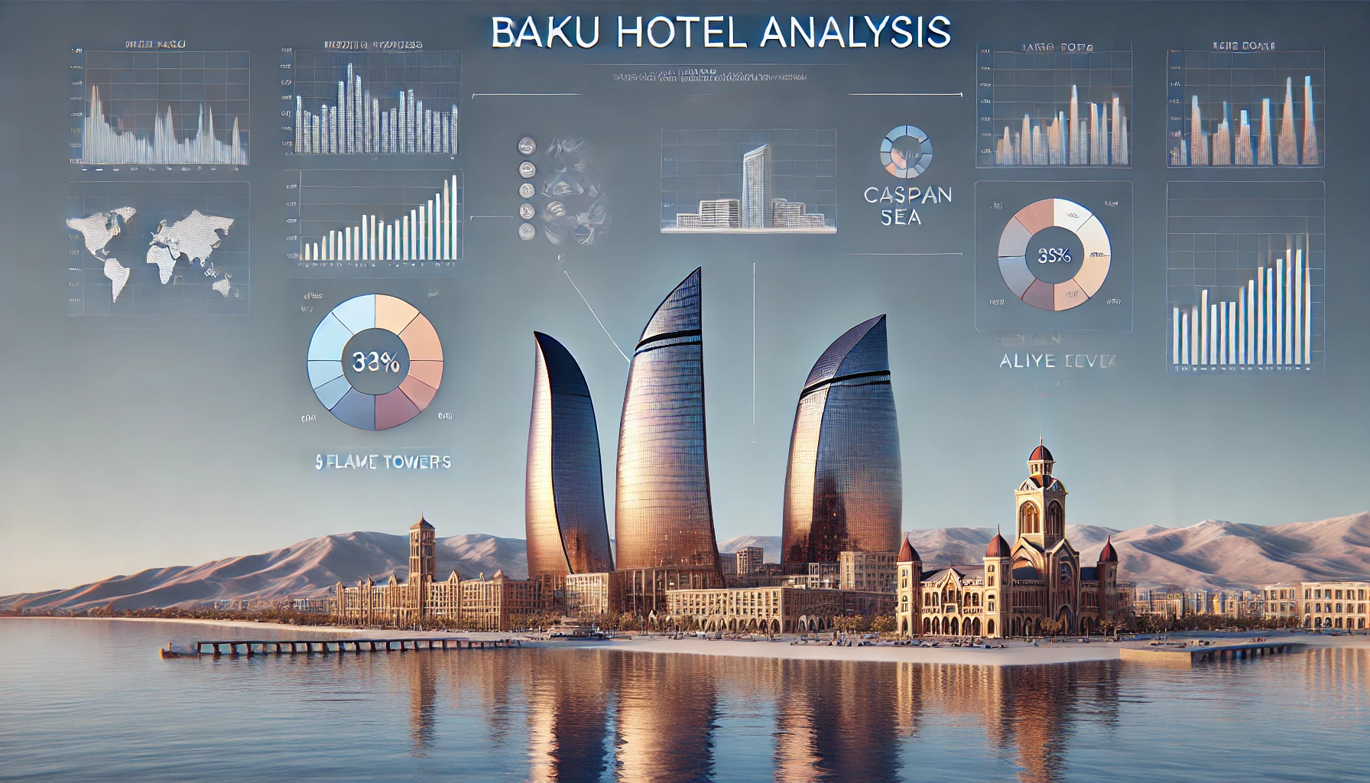

Slide 2
How This Analysis Supports Hotel Success and Enhances Guest Experience
Empowering Hotels:
Identify Improvements: Highlights areas for service and amenity enhancements.
Boost Satisfaction: Addresses issues to elevate guest loyalty and positive reviews.
Enhance Loyalty Programs: Personalizes rewards to strengthen guest connections.
Streamline Operations: Improves staff training and service efficiency.
Enriching Guest Experience:
Personalized Services: Offers tailored recommendations and welcome experiences.
Informed Choices: Provides insights for better hotel selection.
Strengthen Loyalty: Encourages repeat visits through enhanced loyalty initiatives.

Slide 3


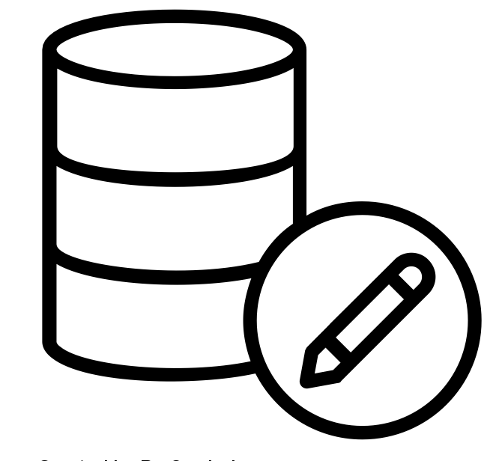
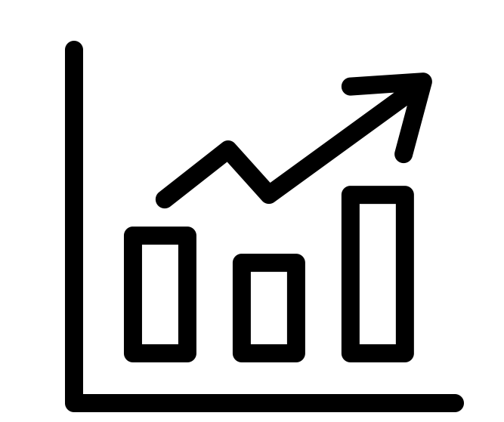
Data Pipeline
Step 1: Scraping Hotel and Review Data Using Python (Beautiful Soup & Selenium)
Step 2: Parsing , Cleaning and Transforming Data into a structured format with Python.
Step 3: Loading Data to Oracle Database and Transforming in SQL Developer
Step 4: Loading Data to Qlik Sense and Creating interactive Visuals for Decision-Making

Slide 4
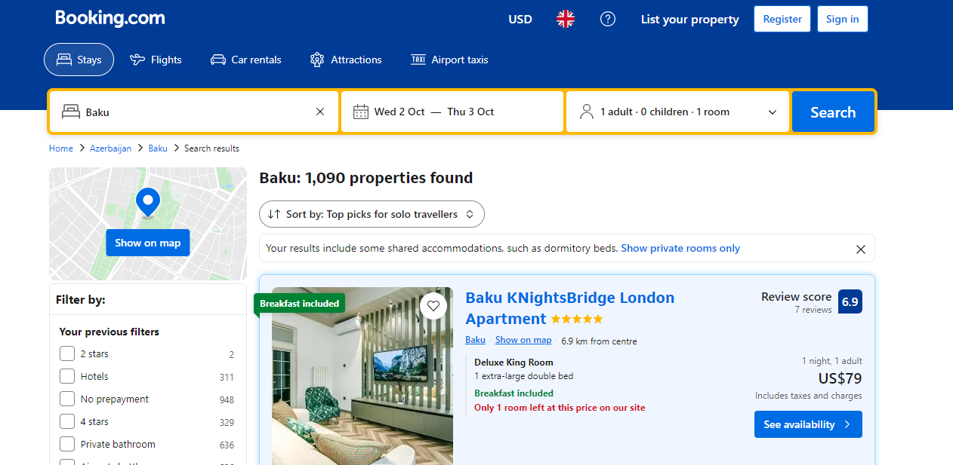

Scraping Hotel Data with Python

Slide 5
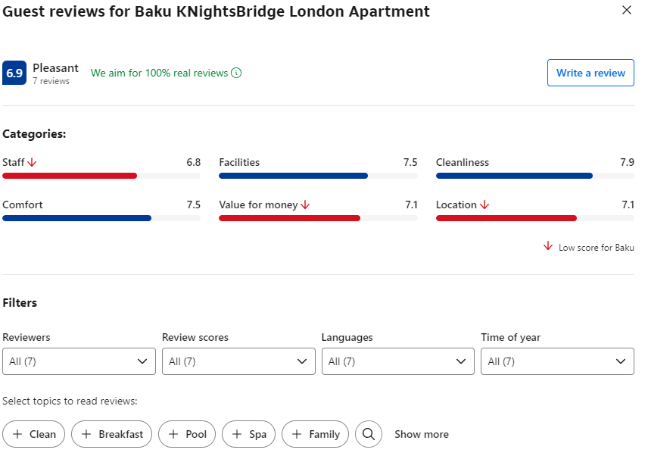
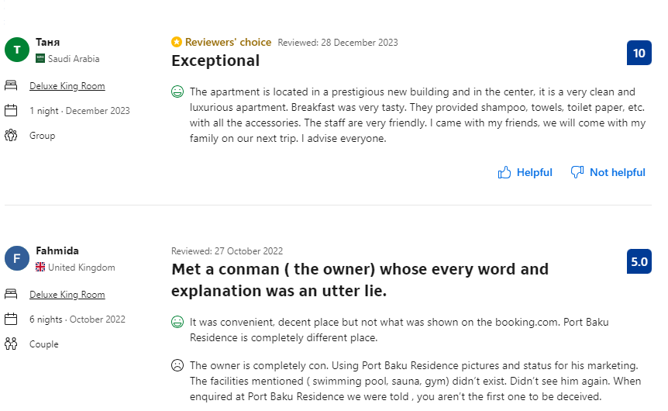
Scraping Review Data with Python

Slide 6
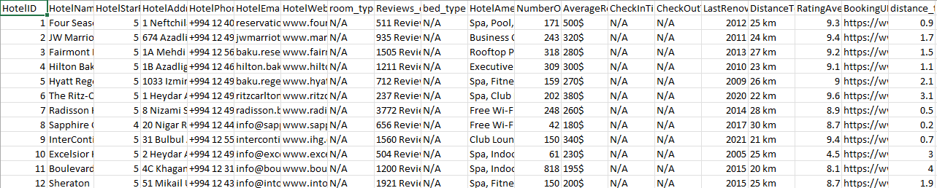
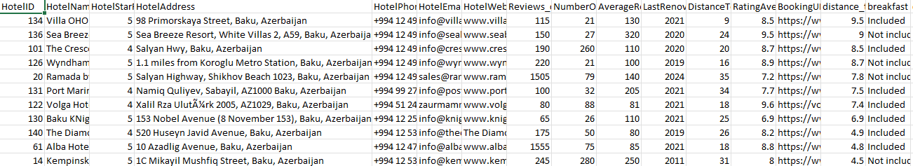
Parsing with Python
Deleted columns with null values to ensure data integrity.
Filled null values with appropriate replacements and checked data types for all columns.

Slide 7
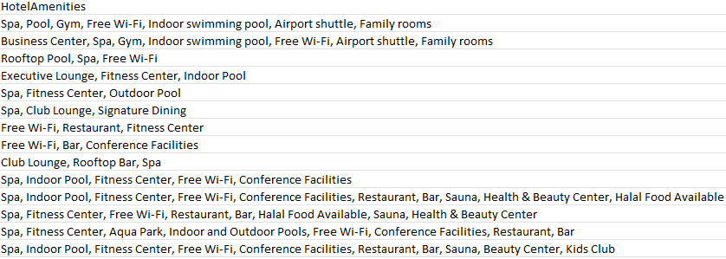
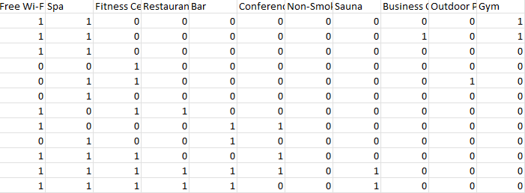
Parsing with Python
The amenities column was converted into a more usable format, and binary columns were created for the most frequent amenities

Slide 8
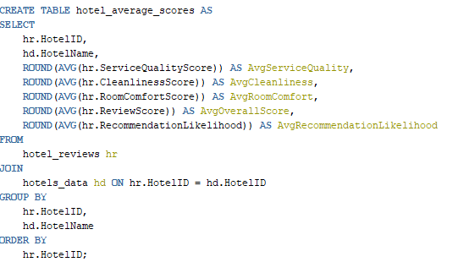
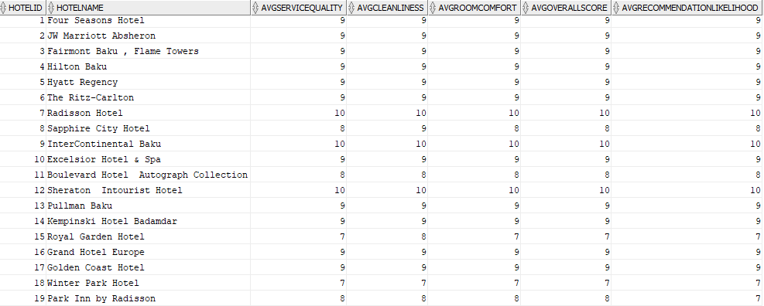
Transform data for more usable format
In SQL checked for data integrity and consistency to ensure reliable results.
Additionally ,wrote SQL queries to extract specific insights and metrics, facilitating a deeper understanding of hotel performance and guest satisfaction.

Slide 9
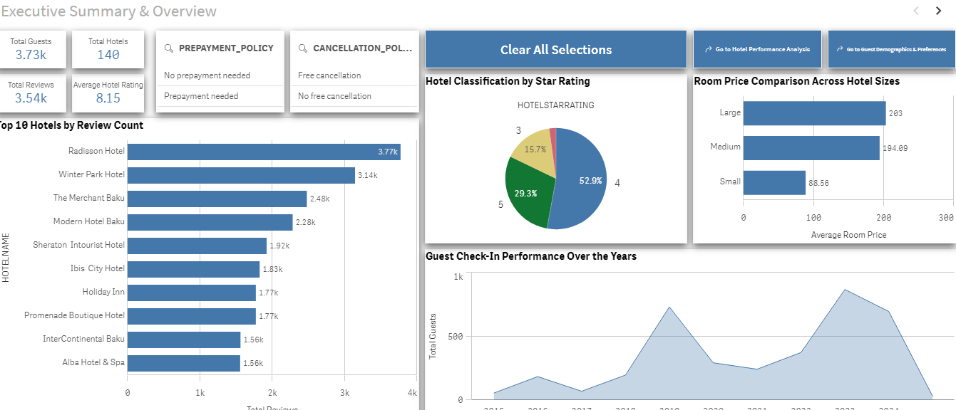

Loading Final data to Qlik Sense and creating Visuals
Database
Qlik Sense

Slide 10
Thank You for Your Attention!
Now, let’s embark on an interactive journey through our Qlik Sense visuals!

